Slide 1


Introduction to MFA Management
Multifactor authentication (MFA) is a critical security measure that helps protect user accounts and sensitive data from unauthorized access. Effective MFA management is essential for organizations of all sizes, as it provides an additional layer of security beyond traditional username and password credentials. In this comprehensive guide, we will explore the fundamentals of MFA, its importance, and best practices for configuring, enabling, and troubleshooting MFA for user accounts.

Slide 2

Understanding MFA and Its Importance
1
What is MFA?
2
Importance of MFA
3
Regulatory Requirements
Multifactor authentication is a security method that requires users to provide two or more pieces of evidence to verify their identity before gaining access to an account or system. These factors can include something the user knows (e.g., a password), something the user has (e.g., a security token), or something the user is (e.g., a biometric such as a fingerprint).
MFA significantly enhances the security of user accounts by making it much more difficult for attackers to gain unauthorized access. Even if a user's password is compromised, the additional authentication factors provide a strong defense against unauthorized access, protecting sensitive data and critical systems.
Many industries and regulations, such as HIPAA, PCI-DSS, and NIST, mandate the use of MFA to protect sensitive information and prevent data breaches. Implementing and maintaining MFA is often a compliance requirement for organizations operating in these regulated environments.

Slide 3
Configuring MFA Settings for Users
Authentication Methods
Policy Configuration
User Enrollment
MFA can be implemented using a variety of authentication methods, including SMS, email, mobile app authenticators, hardware security tokens, and biometrics. The choice of method should be based on the organization's security requirements, user preferences, and the availability of supporting technologies.
Organizations should develop and enforce clear MFA policies that define the authentication methods allowed, the conditions for MFA enforcement (e.g., high-risk transactions, remote access), and the procedures for managing MFA-related tasks such as enrollment, reset, and troubleshooting.
The MFA enrollment process should be simple and intuitive for users, guiding them through the set-up of their preferred authentication methods. Comprehensive documentation and training resources can help ensure a smooth user experience and increase MFA adoption.

Slide 4

Enabling MFA for New User Accounts
1
Account Creation
When a new user account is created, the MFA enrollment process should be seamlessly integrated into the onboarding workflow. This ensures that MFA is enabled for the account from the very beginning, providing immediate protection for the user's access to the organization's systems and data.
2
Authentication Method Selection
During the account creation process, new users should be prompted to select their preferred MFA authentication method, such as SMS, mobile app, or hardware token. This allows them to choose the option that best fits their needs and devices, increasing the likelihood of MFA adoption and usage.
3
Verification and Enrollment
After selecting their authentication method, new users should be guided through the enrollment process, which may involve steps such as verifying their phone number, downloading an authenticator app, or activating a hardware token. This ensures that the MFA setup is completed correctly and the user is ready to access the organization's resources securely.

Slide 5

Resetting MFA for Existing Users
Forgotten Authentication Factors
Device Changes or Replacements
Over time, users may lose or forget their MFA authentication factors, such as a security token or the login credentials for their authenticator app. Providing a secure and efficient process for resetting these factors is crucial to ensure users can regain access to their accounts without compromising security.
When users acquire new devices or change their phone numbers, they may need to update their MFA settings. Implementing a streamlined MFA reset process allows users to easily transfer their authentication factors to the new device, minimizing disruptions to their work and maintaining the overall security posture.
Terminated Employees
Compromised Accounts
When an employee leaves the organization, their MFA settings should be promptly disabled to prevent unauthorized access. Having a clear process for MFA reset and deactivation helps ensure that former employees cannot continue to access sensitive company resources after their employment has been terminated.
In the event of a suspected account compromise, the MFA settings for the affected user should be quickly reset to mitigate the risk of further unauthorized access. This process should be well-documented and easily accessible to the IT team to ensure a rapid response and effective remediation.

Slide 6





Troubleshooting MFA-Related Issues
Authentication Failures
Users may occasionally encounter issues with their MFA authentication, such as failed SMS deliveries, push notifications not being received, or hardware tokens malfunctioning. Providing a clear troubleshooting guide and a responsive support process can help users resolve these problems quickly and maintain access to their accounts.
Enrollment Challenges
The MFA enrollment process may also present challenges for some users, particularly if they are unfamiliar with the required authentication methods or have difficulty setting up their devices. Offering comprehensive guidance and personalized assistance can help ensure a smooth enrollment experience and increase MFA adoption across the organization.
Integration Issues
In some cases, MFA may not integrate seamlessly with existing systems or applications, leading to compatibility problems or user experience issues. Proactively addressing these integration challenges and providing clear communication to affected users can help maintain the effectiveness and reliability of the MFA implementation.

Slide 7
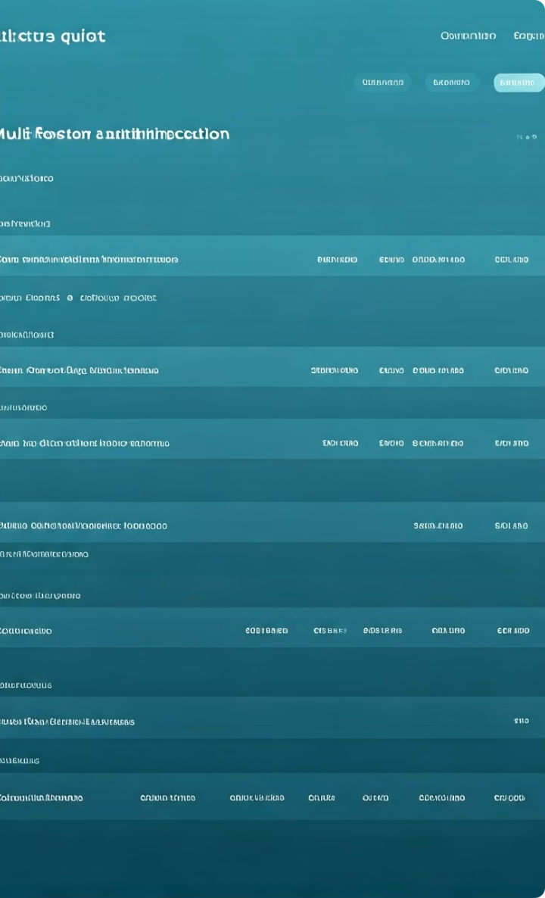



Reporting and Auditing MFA Usage
Usage Monitoring
Regularly monitoring and analyzing MFA usage data can provide valuable insights into the adoption and effectiveness of the MFA implementation. This includes tracking metrics such as the number of active MFA enrollments, successful and failed authentication attempts, and user-specific MFA activity.
Compliance Auditing
Maintaining detailed records of the MFA configuration, policies, and user activities is essential for regulatory compliance and security audits. Regularly reviewing and reporting on these MFA-related metrics can help demonstrate the organization's commitment to protecting sensitive data and meeting industry standards.
Risk Identification
Analyzing MFA usage data can also help identify potential security risks, such as unusual authentication patterns or suspicious user behavior. This information can then be used to implement additional security measures, update MFA policies, or provide targeted user training to mitigate identified threats.

Slide 8

Best Practices for MFA Management
User Education
1
Educating users on the importance of MFA and providing clear guidance on enrollment, usage, and troubleshooting can significantly improve MFA adoption and reduce support requests. Regular training and communication efforts can help users understand the security benefits and develop good MFA habits.
2
Centralized Administration
Implementing a centralized MFA management system allows IT administrators to easily configure, monitor, and maintain MFA settings across the organization. This unified approach helps ensure consistent policy enforcement, streamline user onboarding and offboarding, and facilitate comprehensive reporting and auditing.
Continuous Improvement
3
Regularly reviewing and updating MFA policies, authentication methods, and supporting technologies is crucial to maintaining the effectiveness of the MFA implementation. Staying informed about emerging security threats, industry best practices, and user feedback can help organizations continuously optimize their MFA strategy.

Slide 9

Integrating MFA with Other Security Measures
Identity and Access Management (IAM)
Integrating MFA with IAM solutions ensures that access to critical resources is protected by strong authentication and authorization controls, providing a comprehensive security framework for user identities.
Privileged Access Management (PAM)
Applying MFA to privileged accounts, such as administrators and executives, adds an extra layer of security to high-risk access, reducing the potential impact of compromised credentials.
Security Information and Event Management (SIEM)
Integrating MFA logs and activity data with a SIEM system enables organizations to monitor and analyze security events, detect anomalies, and respond to potential threats more effectively.
Endpoint Protection
Combining MFA with endpoint security solutions, such as antivirus and anti-malware software, helps prevent unauthorized access to devices and protect against malware that may target user credentials.

Slide 10

Conclusion and Key Takeaways
In conclusion, effective MFA management is a critical component of a comprehensive cybersecurity strategy. By understanding the importance of MFA, configuring settings for users, enabling MFA for new accounts, resetting MFA for existing users, and troubleshooting related issues, organizations can significantly enhance the security of their systems and data. Furthermore, by reporting and auditing MFA usage, and implementing best practices for MFA management, organizations can ensure the long-term effectiveness and reliability of their MFA implementation. By integrating MFA with other security measures, organizations can create a robust and resilient security posture that protects against the evolving threat landscape.

